Slide 1
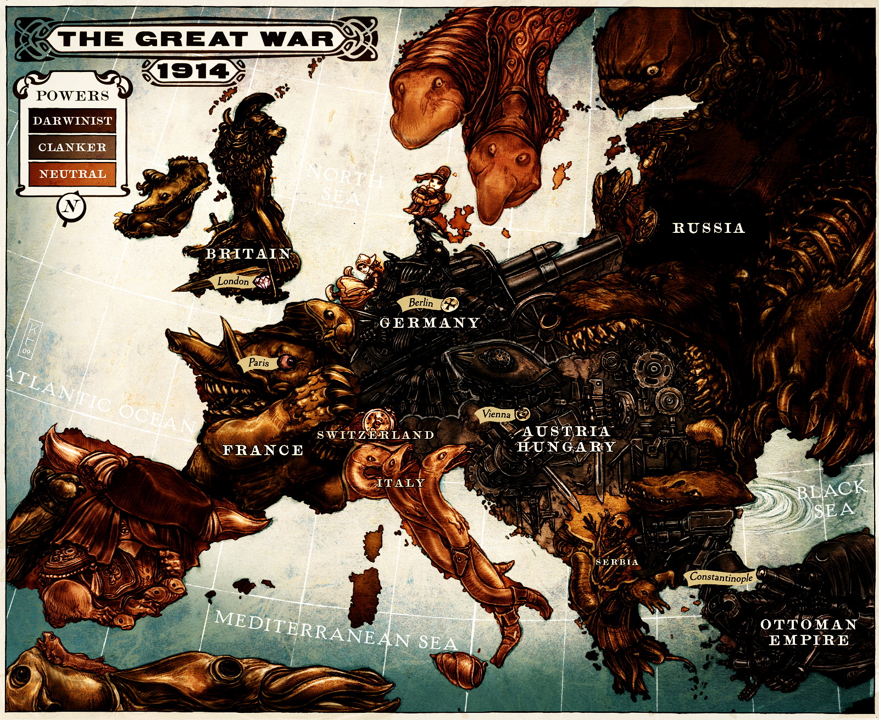

Slide 2
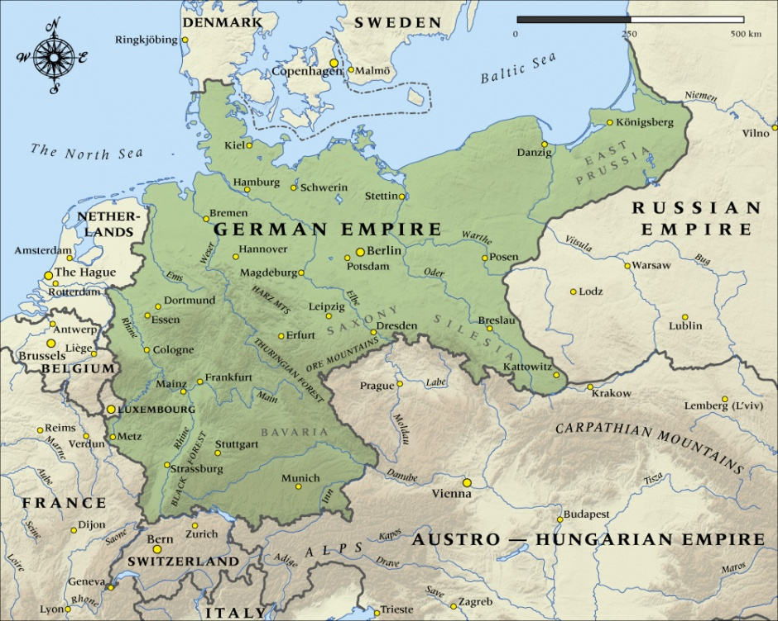
Map of das Deutschland
Capital: Berlin
Other Major Cities: Hannover, Breslau
Important Geo Features: At this time in history, the Germans occupied Alsace-Lorraine, a previously French territory rich with natural resources which would expand the German economy.

Slide 3
Government
From the unification of Germany up until the German Revolution, the government of deutschland was a Federal monarchy, run by the Kaiser who was in power at the time. After Kaiser Wilhelm II was overthrown, Germany had a parliament for about 1 month before they became a republic.
Leaders: Kaiser WIlhelm II
Relations: Allied to Austro-Hungarian empire. Brother-in-Law to king Constantine the 1st, of Greece.
Time: 1871-1918. 47 years

Slide 4
People of Deutschland
Cultures: Germanic (after unification of all the German states, cultures essentially melded together into a single one, which wasn't difficult since most had similar if not the exact same traditions.)
Ethnicities: Germans, Jews
Religion: Protestant, Jewish

Slide 5
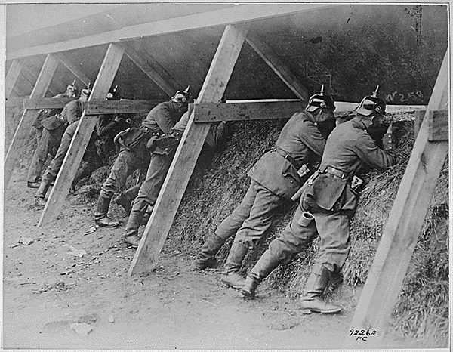
World War I
Alliance: Central
Impact: essentially made what was a petty war of vengeance into a World War. German troops fought tooth and nail against the allied forces during the war, never giving an inch to the enemy until the war so battered and beaten that it was physically impossible to continue fighting. They used “infiltration tactics” were elite troops, called stormtroopers, would rush the enemies trench through a fog of gas, wearing gas masks and armed with bayoneted rifles and one of the first smgs(the MP 18), would storm the trench and capture it from the enemy. After the war, Germany lost Alsace-Lorraine to France, and were forced to pay war reparations.

Slide 6
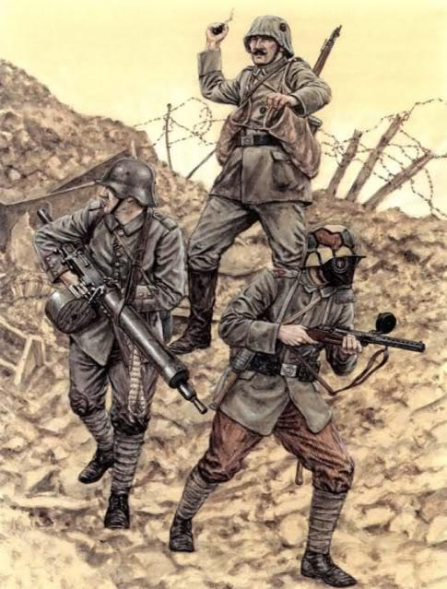
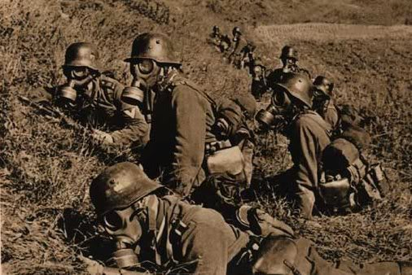
Sturmtruppen
These images show German stormtroopers, a german assault unit that was used to take trenches. The tactics used by stormtroopers consisted of heavy artillery bombardments and then a quick trench infiltration. Stormtroopers were equipped with many different tools to help them infiltrate trenches as a single unit. Examples would be wire cutters and SMGs.

Slide 7
Citations
"Germany." Wikipedia, The Free Encyclopedia. Wikipedia, The Free Encyclopedia, 6 Nov. 2015. Web. 9 Nov. 2015.

